Slide 1

PREDICTING THE USERS FOR CARAVAN INSURANCE POLICY
- TEAM SUPREME

Slide 2

MEET OUR TEAM
SAI BHARADWAJa
SRI RAM
YOGESH
ASWITH
REVaNTH
TARUN

Slide 3
AGENDA
Introduction​
Business Problem
​Benefits
​Past Analysis
Data Processing
Conclusion
Scope for the future

Slide 4
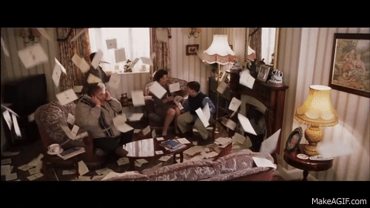
Introduction
Email is one of the most important mediums for converting users into clients. Email marketing is one of the most measured and effective kinds of marketing. Spamming customers who are not interested in insurance policies with emails will cost the firms a lot of money. So, we are developing a ML model for predicting the customers who are interested in purchasing an insurance policy.

Slide 5
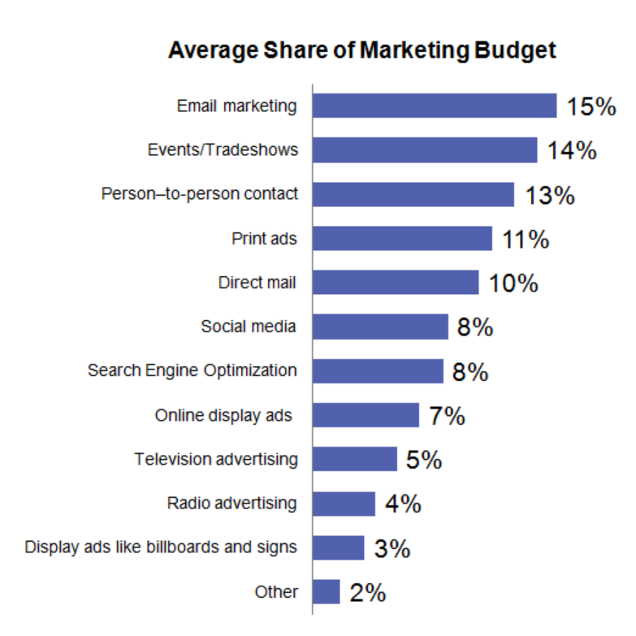
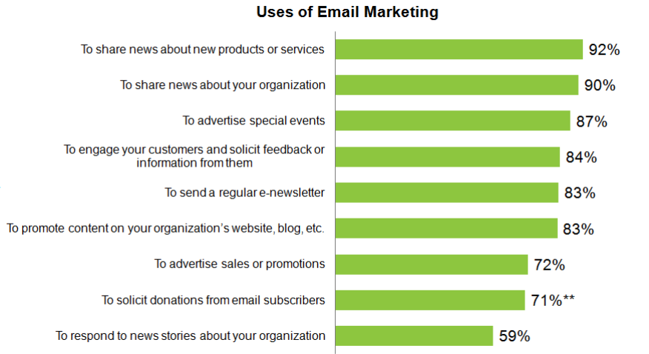
Average email marketing statistics

Slide 6
Business problem
Optimizing Marketing Resource

Slide 7
BUSINESS PROBLEM
Resource Management for marketing is often a big concern for every insurance Company
In order to solve this issue in optimum manner, a machine learning model is developed
Identify potential clients that are interested in caravan insurance policies.
Finding out the behaviour of existing customers

Slide 8



BENEFITS
ROI
Competitive MARKETS
Strategies
Insurance companies will get a high ROI, as they can predict their clients using the developed model.
So, there will be a high demand for insurance companies' growth as they can only focus on their customers by giving a best benefits and customer services.
Optimizing marketing strategies for best usage of their resources along with the time to achieve better productivity.

Slide 9
WheN GOD Doesn't ANSWER YOUR PRAYERS, INSURANCE GOT YOUR BACK.
“
”

Slide 10

PAST ANALYSIS

Slide 11
PAST ANALYSIS
Earlier analysis involved
New combination of features were created using feature engineering and various models like Naive Bayes, LDA, Neural networks are used.
Various feature selection techniques like wrapper and filter methods are used.
Only 122 customers out of 238 were predicted.
Considered inly 9 attributes for making predictions.

Slide 12
DATA DESCRIPTION
The dataset contains statistics about customer’s product usage data and socio-demographic data derived from zip area codes.
The training set contained information on 5822 customers, of which 348, about 6%, had caravan policies. The test set contained information on 4000 customers randomly drawn from the same population. For each customer, the values of 85 features were given

Slide 13



Data cleaning process
Initial data set
Data cleansing
Target variable
CONTAINS 85 ATTRIBUTES WITH 9822 OBSERVATIONS
REMOVED VARIABLES WITH NEGLIGIBLE CORRELATED VALUES AND ENDED UP WITH 17 ATTRIBUTES
UNIQUE VARIABLE “CARAVAN POLICY”

Slide 14
DATA PROCESSING
IMPORTING
SAMPLING
TRAINING
MODELING
PREDICTING
Import all required libraries and load the dataset.
Clean the data and prepare it for analysis.
Address the data imbalance using the over-sampling or under-sampling techniques
Train the dataset by splitting into a 80/20 split.
80% of the data is used for training the model and 20% is for testing the model.
K-NN
Decision Tree
Random Forest
Gradient Boosting
XGBoost
Finding out the that best fit model and predicting the users interested in Caravan Insurance policy

Slide 15
DATA ANALYSIS
Customers who purchase more fire policies tend to contribute more towards buying caravan insurance
Customers whose avg no of houses is less than 2 tend to contribute more towards buying caravan insurance
Customers whose income is less than 30,000$ and live in rented house tend to contribute more towards buying caravan insurance.
Customers who purchased more no of car policies tend to contribute more towards buying caravan insurance

Slide 16
FINAL PREDICTORS
SOCIO DEMOGRAPHIC FEATURES
AVERAGE INCOME
PRODUCT BASED FEATURES
CONTRIBUTION IN CAR POLICIES
NATIONAL HEALTH SERVICE
RENTED HOUSE
HOMEOWNERS
NO CAR
INCOME LESS THAN 30000
HIGHER LEVEL EDUCATION
LOWER-LEVEL EDUCATION
NUMBER OF CAR POLICIES
CONTRIBUTION IN FIRE POLICIES
CONTRIBUTION IN PRIVATE THIRD PARTYINSURANCES
NUMBER OF PRIVATE THIRD-PARTY POLICIES
NUMBER OF BOAT POLICIES
CONTRIBUTION OF BOAT POLICIES
PURCHASING POWER CLASS
CUSTOMER SUB TYPE

Slide 17
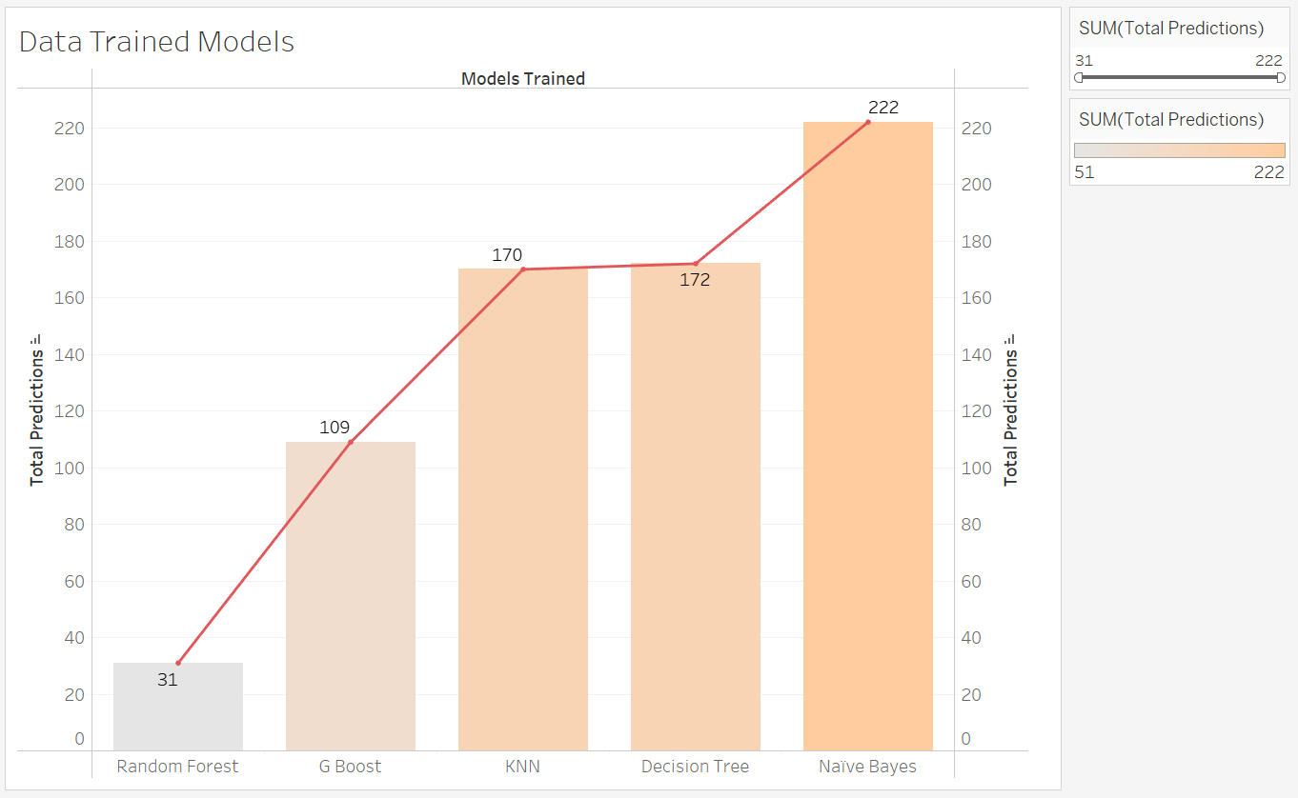
Predicted OUTPUTS

Slide 18
Conclusion
Designed multiple models based on available data to identify potential customers.
The models are optimized for recall score to reduce false negatives, thereby reducing the possibility of large losses to the insurance firms.
Naive Bayes model provided best solution by predicting 222 customers, helping Insurance companies to target set of customers thereby reducing the marketing costs.

Slide 19

scope FOR THE FUTURE

Slide 20
scope FOR THE FUTURE
Developed Model can be used for predicting users who all are interested in other type of insurances.
New set of features can be created by using feature engineering.
New features selection techniques can be implemented.
Marketing strategies can be implemented.

Slide 21
MARKETING STRATERGIES
Area-Focused Marketing:
Advertising Campaign:
Marketers could concentrate on marketing methods that are most appropriate and likely to attract customers in each specific area.
The insurance business could look for cross-selling opportunities by knowing who its potential clients are (risk-averse and rich)
Bundled products:
Joint Marketing:
The insurance business might offer potential consumers a combined package of auto insurance and caravan insurance.
Marketers might arrange a joint marketing event with caravan manufacturers to reach potential clients and raise their risk awareness.

Slide 22

SO, TRANSFORMERS WOULD HAVE AUTO INSURANCE or
HEALTH INSURANCE

Slide 23
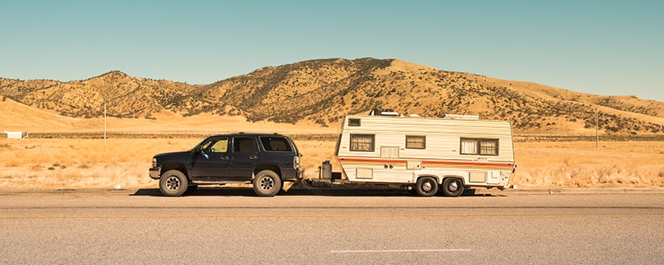
THANK YOU
GET INSURED

